Slide 1

Introduction to Bitcoin
Garret Tonra : G00341908
Supervisor : martin Kenirons

Slide 2


Slide 3
Contents
What is Bitcoin
How bitcoin Works
Bitcoin mining
Advantages & disadvantages of bitcoin
Future of Bitcoin

Slide 4
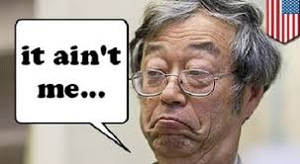
What is Bitcoin ?
Bitcoin was created in October 2008 by an unknown entity that goes by the name Satoshi Nakamoto
The first Bitcoin specification and proof of concept was published in 2009 in a cryptography mailing list by Satoshi
Bitcoin is the first “Open Source Decentralized Digital Cryptocurrency”
1 Bitcoin = 6540.00 Euro approx.

Slide 5
What is Bitcoin ?(CONTINUED)
Bitcoin is a form of digital currency, created and held electronically. No one controls it.
Bitcoins aren’t printed like dollars or euros
Bitcoins are produced by people, and businesses
Bitcoin uses peer-to-peer technology to operate with no central authority

Slide 6
Uses of Bitcoin
Unlimited uses
Developing world
Bitcoin was used by users for buying illegal contraband from sites like silk road

Slide 7
How Bitcoin Works ?
From a user perspective, Bitcoin is nothing more than a mobile app or computer program that provides a personal Bitcoin wallet and allows a user to send and receive bitcoins with them
Every ”account” consists of the public key (bitcoin address) and the private key.
Anyone who knows your public key, can send you bitcoins.
To spend bitcoins, you have to know the private key.
The transaction is broadcasted to the bitcoin network.
The miners confirm the transactions

Slide 8
How Bitcoin Works ?
An example of a bitcoin address: 14nRKoXJAUpKYYbzw6Yrqh9gW2p26zerpW
The corresponding private key: 5HuEupX3DNFJ7UypjFtXDTm4BVuAwZtAgY f94sMALPyakgafVnU

Slide 9
How Bitcoin Works ?
Behind the scenes, the Bitcoin network is sharing a public ledger called the blockchain. This ledger contains every transaction ever processed, allowing a user's computer to verify the validity of each transaction
In the process called mining, all transactions are collected in a block. A new block is mined in about every 10 minutes.
For small payments or payments with a trusted peer, 0 confirmations is usually ok.
For large amounts, 6 confirmations is considered safe.

Slide 10
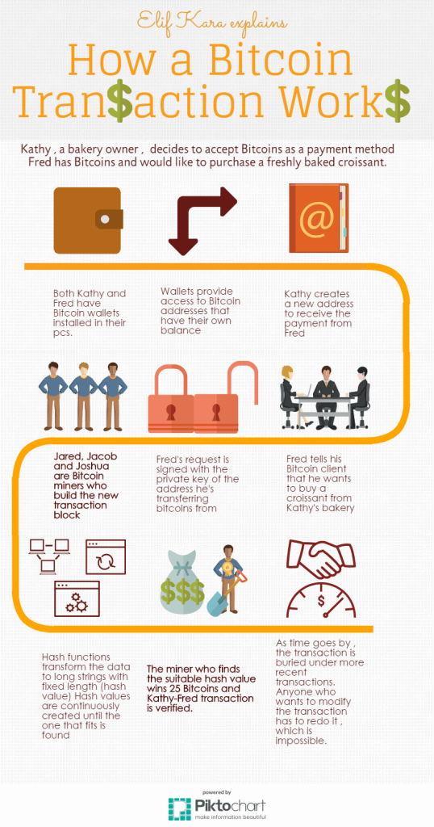

Slide 11

Bitcoin Mining
What is Bitcoin mining?
Mining is the process of spending computing power to process transactions, secure the network, and keep everyone in the system synchronized together
Anybody can become a Bitcoin miner by running software with specialized hardware.
Bitcoin miners use special software to solve mathematical problems and are issued with bitcoins in exchange for this service as well as transaction fees paid by users for faster transaction processing, this offers the network a smart way to issue the currency in a regulatory manner.

Slide 12
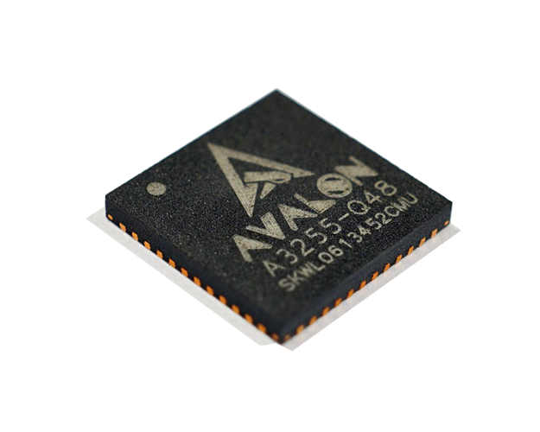
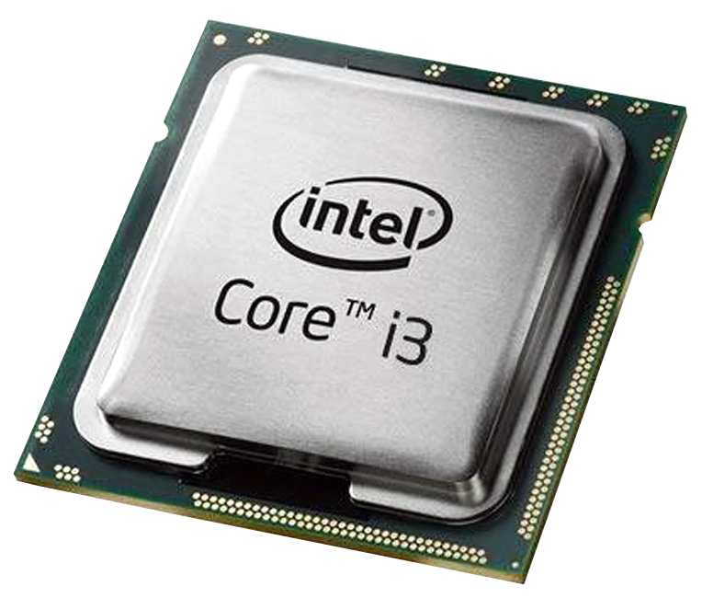
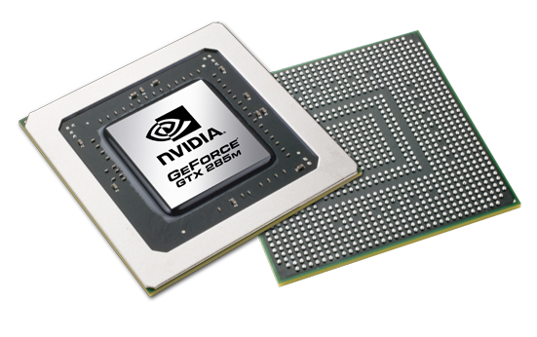
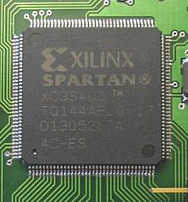
Bitcoin miners
Since the miners need to approve transactions then the more miners the network has the more secure the network is.
The bitcoin network automatically changes the difficulty of the maths problems depending on how fast the problems are being solved.
Hardware for Miners
CPU GPU FPGA ASIC

Slide 13
Advantages Of bitcoin
Payment freedom - It is possible to send and receive any amount of money instantly anywhere in the world at any time. No bank holidays. No borders. No imposed limits.
Very low fees - Bitcoin payments are currently processed with either no fees or extremely small fees.
Fewer risks for merchants - Bitcoin transactions are secure, irreversible, and do not contain customers’ sensitive or personal information. This protects merchants from losses caused by fraud
Security and control - Bitcoin payments can be made without personal information tied to the transaction. This offers strong protection against identity theft. Bitcoin users can also protect their money with backup and encryption.
Transparent and neutral - All information concerning the Bitcoin money supply itself is readily available on the block chain for anybody to verify and use in real-time

Slide 14
Disadvantages of bitcoin
Degree of acceptance - Many people are still unaware of Bitcoin. Every day, more businesses accept bitcoins because they want the advantages of doing so, but the list remains small and still needs to grow in order to benefit from
Volatility - The total value of bitcoins in circulation and the number of businesses using Bitcoin are still very small compared to what they could be. So relatively small events, trades or business activities can significantly affect the price. In theory, this volatility will decrease as Bitcoin markets, the technology matures and Bitcoin interest rates normalize.
Easy to lose - There is no mechanism for lost or stolen coins once there gone there gone
Energy Use Due to Mining Farms – since mining farms have started they have had a negative impact on energy consumption worldwide

Slide 15
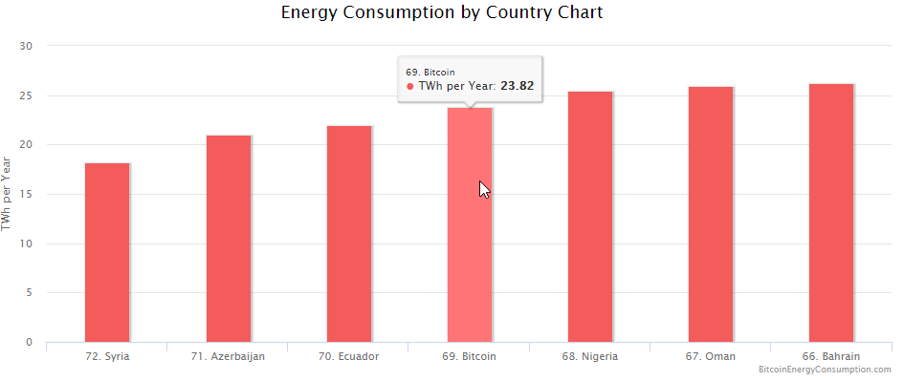
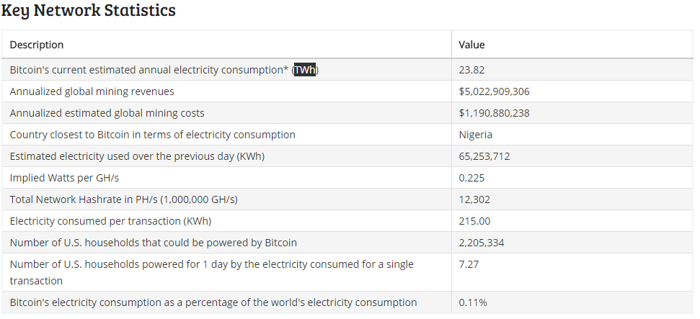
Energy Usages of Bitcoin Worldwide

Slide 16
Future of Bitcoin
Bitcoin fails
People lose faith in Bitcoin
A race to the bottom – prices spiral to $0
The way down might take a while, like the way up
Bitcoin stagnates
Bitcoin prices reach a stable price level
It becomes some small percent of the world economy
Used for some purposes, mostly on the internet
Bitcoin wins
More and more people see the benefits
They trade Fiat money for BTC
Bitcoin is a major part of the world economy

Slide 17
